Slide 1
CS 347 Project
Erica Halpern, Lindsey Kehlmann, & Michelle Lawrence

Slide 2
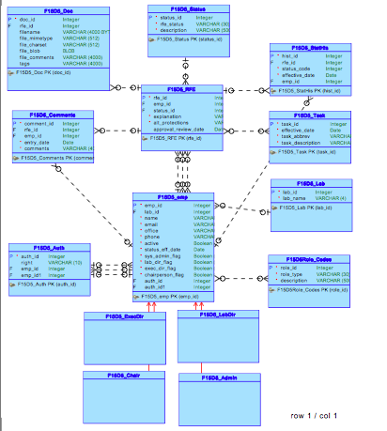

Slide 3
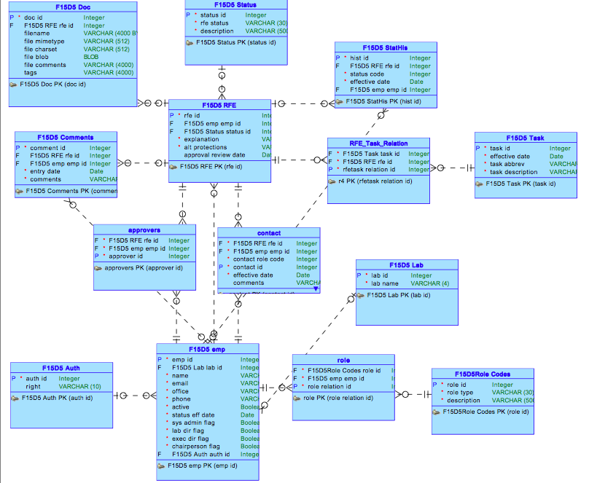

Slide 4
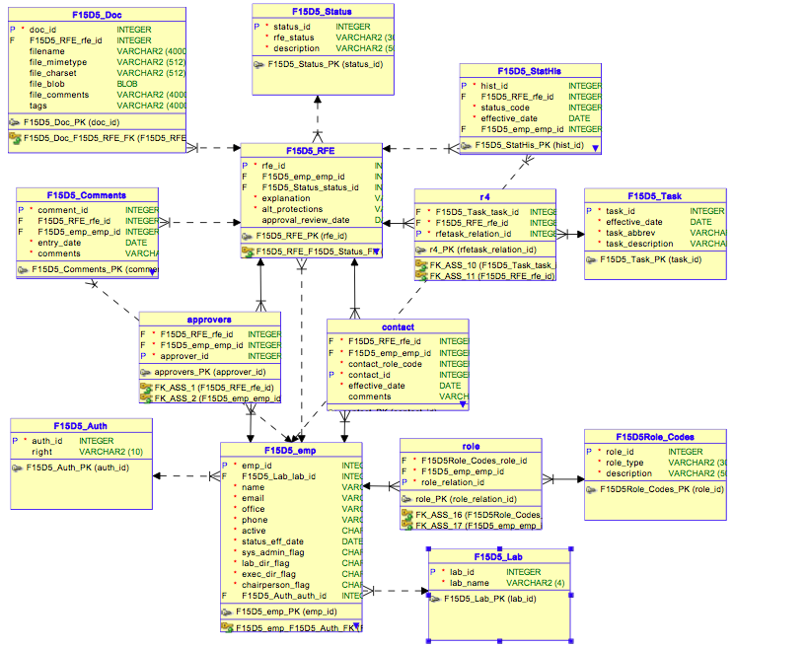

Slide 5
Application screenshots

Slide 6
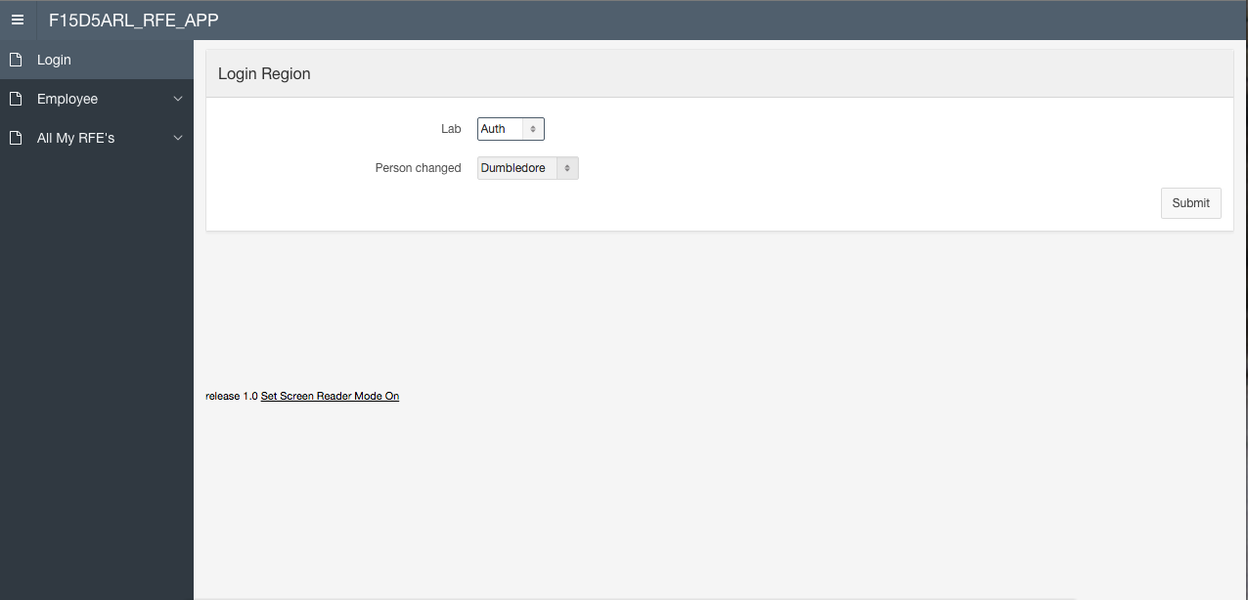

Slide 7
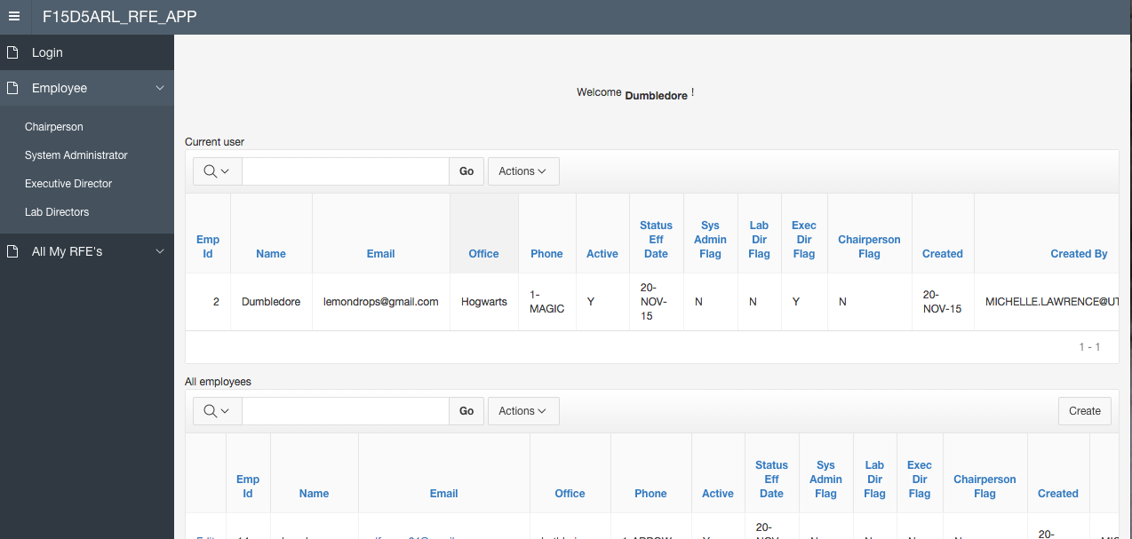

Slide 8
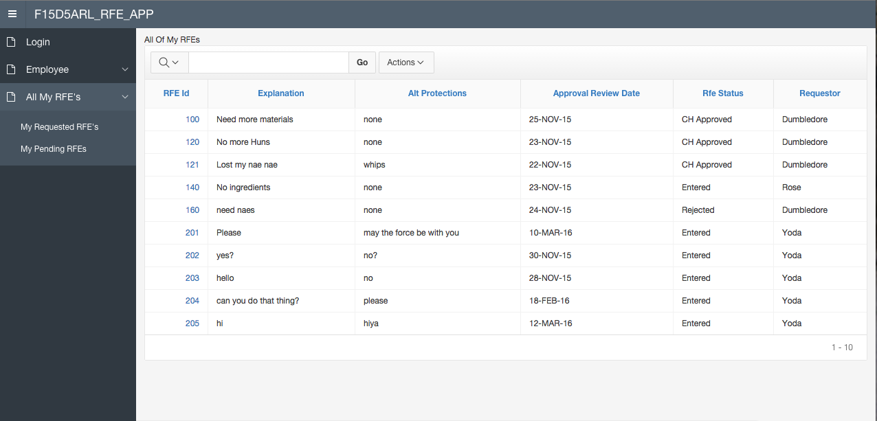

Slide 9
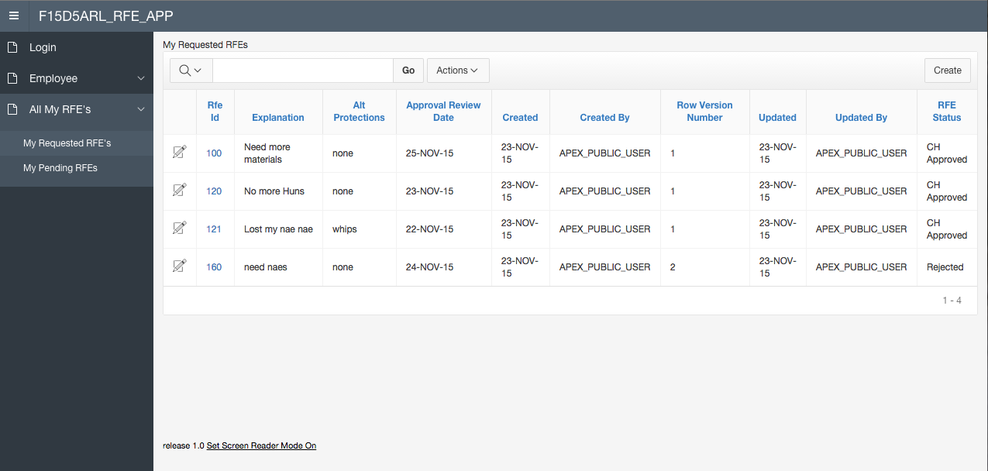

Slide 10
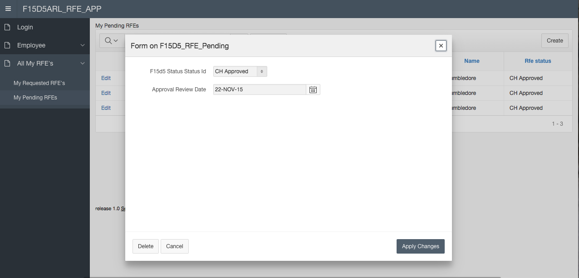

Slide 11
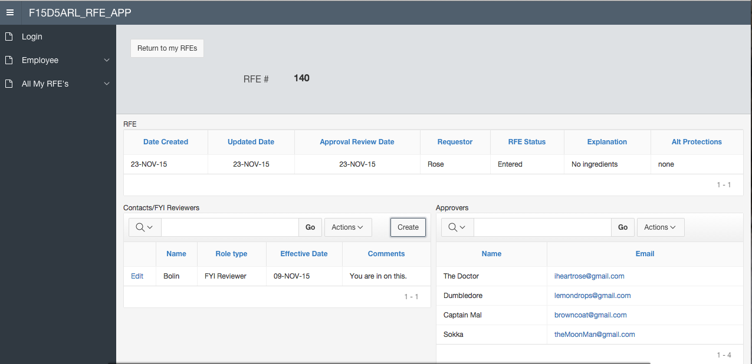

Slide 12
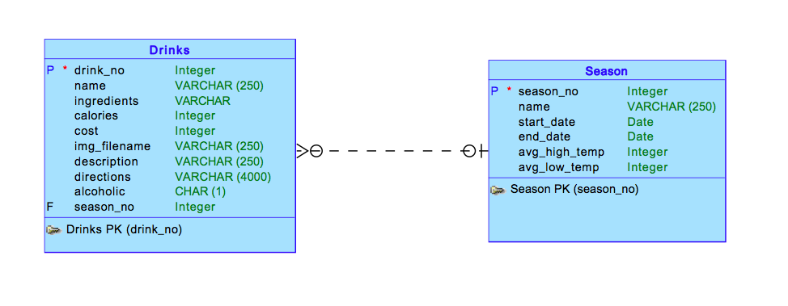
Part II Conceptual Model

Slide 13
Part II Description and screenshots
Part II of our project is meant to act like a beverage menu depending on season.
Seasonal drinks are displayed with prices, descriptions, ingredients, etc.

Slide 14

Drink Recipes
Returns ingredients and directions

Slide 15
Drink Menu
Lists price, description, and corresponding season

Slide 16
Seasons
Table information defining our different seasons

Slide 17
Github repo

